Slide 1
Class Diagrams

Slide 2
Class Diagrams
An object is any person, place, thing, concept, event, screen, or report applicable to your system. Objects both know things (they have attributes) and they do things (they have methods). A class is a representation of an object and, in many ways, it is simply a template from which objects are created. Classes form the main building blocks of an object-oriented application. Although thousands of students attend the university, you would only model one class, called Student, which would represent the entire collection of students

Slide 3
Class Diagrams
Classes are typically modeled as rectangles with three sections: the top section for the name of the class, the middle section for the attributes of the class, and the bottom section for the methods of the class.

Slide 4
Class Diagrams
Attributes are the information stored about an object (or at least information temporarily maintained about an object), while methods are the things an object or class do. For example, students have student numbers, names, addresses, and phone numbers. Those are all examples of the attributes of a student. Students also enroll in courses, drop courses, and request transcripts. Those are all examples of the things a student does, which get implemented (coded) as methods. You should think of methods as the object-oriented equivalent of functions and procedures.

Slide 5
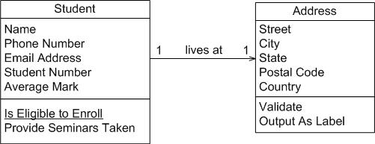
Class Diagrams

Slide 6
Class Diagrams
An important consideration the appropriate level of detail.
When you stop and think about it, addresses are complicated things. They have complex data, containing street and city information for example, and they potentially have behaviour.
Notice how the Address class has been modeled to include an attribute for each piece of data it comprises and two methods have been added: one to verify it is a valid address and one to output it as a label (perhaps for an envelope). By introducing the Address class, the Student class has become more cohesive. It no longer contains logic (such as validation) that is pertinent to addresses.

Slide 7
Class diagrams
The Address class could now be reused in other places.
Furthermore, if the need arises to support students with several addresses during the school term, a student may live in a different location than his permanent mailing address, such as a home and term addresses. Information the system may need to track. Having a separate class to implement addresses should make the addition of this behaviour easier to implement.

Slide 8
Class Diagrams
Another option for associations is to indicate the direction in which the label should be read. This is depicted using a filled triangle, called a direction indicator, an example of which is shown on the offering of association between the Seminar and Course classes of diagram below. This symbol indicates the association should be read “a seminar is an offering of a course,” instead of “a course is an offering of a seminar.” Direction indicators should be used whenever it isn’t clear which way a label should be read. My advice, however, is if your label is not clear, then you should consider rewording it.

Slide 9
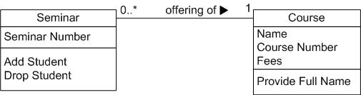
Class Diagrams

Slide 10
Class Diagrams
The arrowheads on the end of the line indicate the directionality of the association. A line with one arrowhead is uni-directional whereas a line with either zero or two arrowheads is bidirectional. Officially you should include both arrowheads for bi-directional associations, however, common practice is to drop them.
At each end of the association, the role, the context an object takes within the association, may also be indicated

Slide 11
Class Diagrams
Similarities often exist between different classes. Very often two or more classes will share the same attributes and/or the same methods. Because you don’t want to have to write the same code repeatedly, you want a mechanism that takes advantage of these similarities. Inheritance is that mechanism. Inheritance models “is a” and “is like” relationships, enabling you to reuse existing data and code easily. When A inherits from B, we say A is the subclass of B and B is the super class of A. Furthermore, we say we have “pure inheritance” when A inherits all the attributes and methods of B. The UML modelling notation for inheritance is a line with a closed arrowhead pointing from the subclass to the super class

Slide 12
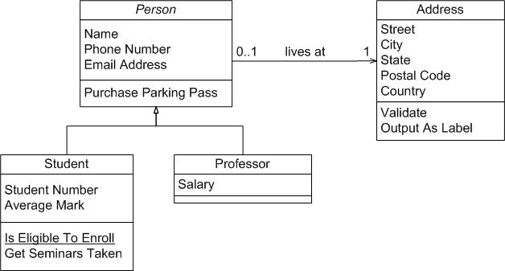
Class diagrams

